Slide 1
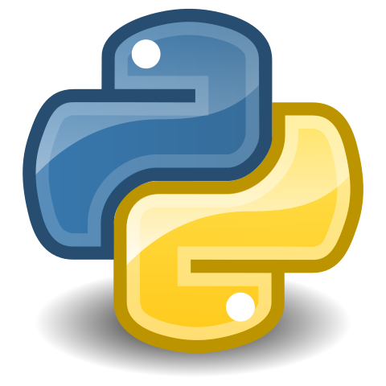
Function
&
Module

Slide 2
FUNCTION IN PYTHON :-
Python function is a block of statements that return the specific task. The idea is to put some commonly or repeatedly done task together and make a function so that instead of writing the same code again and again for different inputs, we can do the function calls to reuse the code contained in it over and over again .
Some benefits of using Functions :
Increase code Readability
Increase code Reusability

Slide 3
Types of functions :-
There are mainly two types :-
Built -in library Function : These are Standard Function in python that are available to use.
User - defined Function : We can create our own function based on our requirements
Defining and calling a function with parameters :-
Def function_name(parameter : data_type)
return _type:
“””Docstring”””
#body of the function
Return expression

Slide 4
Function Examples :-
>>>def hello(name)
… results =”Hello World to”+name+” ”
… return results
…
>>> hello()
Traceback(most recent call last):
File “<stdin>”.line 1,in <module>
TypeError.hello() takes exactly 1 argument (0 given)
‘Hello World to Text’
>>>
TASK : make script from this take name from command line
PRINT: result to screen

Slide 5
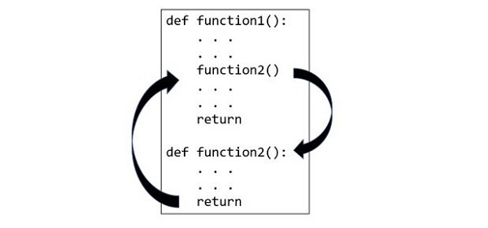
A function is a block of organized, reusable code that is used to perform a single, related action. Functions provide better modularity for your application and a high degree of code reusing.
A top-to-down approach towards building the processing logic involves defining blocks of independent reusable functions. A function may be invoked from any other function by passing required data (called parameters or arguments). The called function returns its result back to the calling environment.

Slide 6
MODULE IN PYTHON :-
A python module is a file containing Python definitions and statements .
A module can define functions , classes, and variables .
A module can also include runnable code.
Grouping related code into a module makes the code easier to understand and use.
It also makes the code logically organized.
IMPORT MODULE
import example_module

Slide 7
A module is a file containing Python definitions and statements.
The file name is the module name with the suffix .py appended.
Within a module, the module’s name (as a string) is available as the value of the global variable __name__.
For instance, use your favorite text editor to create a file called fibo.py in the current directory with the following contents.
Modules can import other modules. It is customary but not required to place all import statements at the beginning of a module (or script, for that matter). The imported module names, if placed at the top level of a module (outside any functions or classes), are added to the module’s global namespace.

Slide 8
USING MODULE
One of two import statements :
1) import module name
2)from module import function/constant
If method 1:
modulename.function(arguments)
If method 2:
1) function(arguments)- module name not needed
2)beware of function name collision

Slide 9
we can define a module in one of 3 ways:
Python itself allows for the creation of modules.
Similar to the re (regular expression) module, a module can be primarily written in C programming language and then dynamically inserted at run-time.
A built-in module, such as the itertools module, is inherently included in the interpreter
A module is a file containing Python code, definitions of functions, statements, or classes. An example_module.py file is a module we will create and whose name is example_module.

Slide 10
Difference between Function & Module :-
The main difference between a module and a function is that a module is a collection of functions that are imported in multiple programs and can do various tasks.
A function is a small block of code and separates itself from the entire code and have a fixed functionality. This function can be used anywhere within the same program whereas modules can be used in multiple programs.

Slide 11
Conclusion :-
Modules and functions both have one main goal that is code reusability. Functions are used for small tasks whereas modules are used for larger tasks as it allows various classes and functions in it.
A module is used by importing it in another program where as a function is used by calling it.

Slide 12


